Slide 1
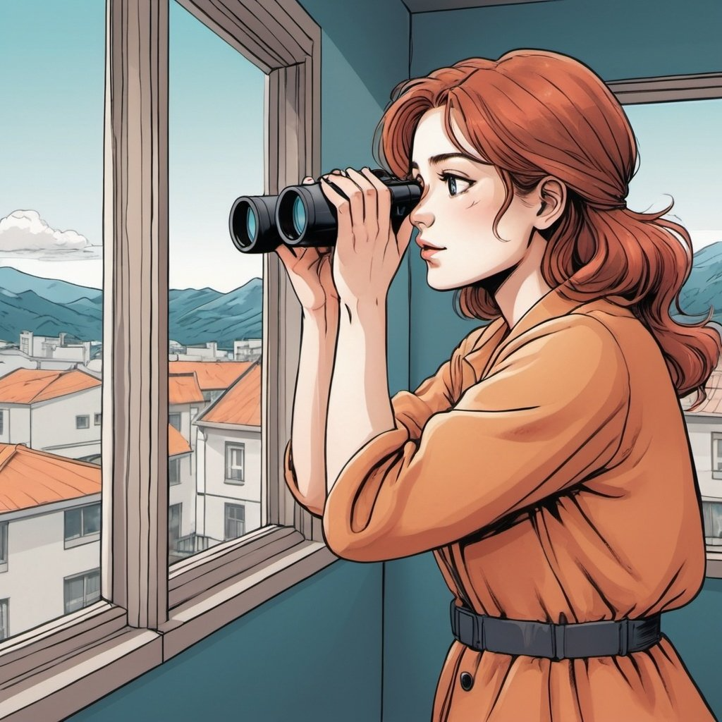
First page visual:
A
The Ultimate Neighbour Quiz
Test your knowledge on your rights and obligations towards your neighbour and determine what kind of neighbour are you!
GO TO THE QUIZZ

Slide 2
Second page visual:
A
Question 1:
Loud music, slamming doors... your neighbour is giving you a hard time! To constitute a night-time disturbance, noise pollution must be committed :
between 9 p.m. and 7 a.m.
between 10 p.m. and 6 a.m.
from sunset to sunrise (so it changes all the time...).
SUBMIT ANSWER

Slide 3
Third page visual:
A
Question 2:
You live in Lausanne and the branches of your neighbour's cherry tree encroach on your property:
you have the right to pick the cherries from the branches overhanging your property.
you can pick the cherries, only if they have fallen from the tree.
You do not have the right to pick the cherries, whether on the tree or on the ground
SUBMIT ANSWER

Slide 4
Fourth page visual:
A
Question 3:
Your neighbour has installed a camera outside his house. Do they have to ask your permission?
Yes, you cannot be sure what he is recording.
No, he or she has the right to protect his/her private property.
It depends where the camera is oriented.
SUBMIT ANSWER

Slide 5
Fifth page visual:
A
Question 4:
Is your neighbour allowed to burn branches, twigs and dead leaves in his garden?
Yes
No
Only in the countryside.
SUBMIT ANSWER

Slide 6
sixth page visual:
A
Question 5:
You are helping your neighbour to dig a hole in his garden for his swimming pool. While he's away, your pick hits a historical chest containing gold coins. Who does this treasure belong to?
Both neighbours.
The neighbour who is the owner of the land.
None of them.
SUBMIT ANSWER

Slide 7
Eighth page visual:
Here is your score!
25 points
You are the perfect neighbour who know his rights and obligations towards your neihbour! Congratulations!
Time Taken:00.10.00:00
HERE ARE THE CORRECT ANSWERS…READY?

Slide 8
Eighth page visual alternative:
Here is your score!
Less than 25 points
You are a good neighbour and you are still learning your rights and obligations towards your neighbour. Way to go!
HERE ARE THE CORRECT ANSWERS…READY?

Slide 9
Eighth page visual alternative:
Here is your score!
Less than 10 points
You are a still struggling with all these rules and you might not have a law-abiding neighbour, time to take time to know your rights and obligations towards your neighbour. You can do it!
HERE ARE THE CORRECT ANSWERS…READY?

Slide 10
sixth page visual:
Question 1 / ANSWER B
In Switzerland, silence is generally required between 10 pm and 6 am. Noisy activities (playing drums, using a drill, etc.) are likewise prohibited between 12 noon and 1 p.m., as well as on Sundays and public holidays.
Question 2 / ANSWER A
You have a right to the fruit, so you can pick them yourself and eat them. The exceptions are (i) if you live in canton of Neuchâtel: you can only pick fruit that has fallen to the ground; (ii) in the canton of Appenzell Inner Rhodes: you have no right to pick fruit, whether on the tree or on the ground.
Question 3 / ANSWER C
Even if the camera is primarily intended to monitor only the neighbour's private property, you may nevertheless be directly affected by this video surveillance, depending on the camera's orientation or certain circumstances (e.g. right of way). If the camera cannot be installed in such a way as to exclude you from its field of view, the neighbour must also consult you beforehand. You can also submit an access request to look at the recordings and ask to delete when necessary.

Slide 11
seventh page visual:
Question 4 / ANSWER A
Small quantities of natural waste from forests or gardens can be incinerated. Strict rules apply, however: the waste must be dry, there must be little smoke, and the fire must not cause excessive nuisance to neighbours.
Question 5 / ANSWER C
If the treasure found is of scientific value (for example, if it contains historical remains), it becomes the property of the canton. However, you are entitled to appropriate compensation.
RESTART THE QUIZZ?
Source of information:
www.edoeb.admin.ch/
www.moneyland.ch/
www.ch.ch
www.raiffeisen.ch
www.energie-environnement.ch

Slide 12
Notes on tasks:
Backend/
HTML
Take the answer and convert into points.
Save the points in a txt file
Timer using
tic = time.perf_counter()
tutorial = feed.get_article(0)
toc = time.perf_counter()
print(f"Downloaded the tutorial in {toc - tic:0.4f} seconds")
Front end/
Save score to local storage (from txt to Local storage)
Delete score = clear Local Storage

